Slide 1


Machines
Division B/C
Georgia Tech Event Workshop Series 2025-26

Slide 2
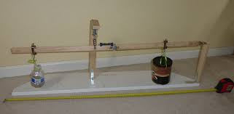
01
Event Overview
02
Basic Math
[Event-Related Image]
03
Basic Mechanics
04
Work and Energy
05
Simple Machines
Notes:
For Builds: Replace difficult topics with physical principles involved in the build and replace common questions with common designs

Slide 3
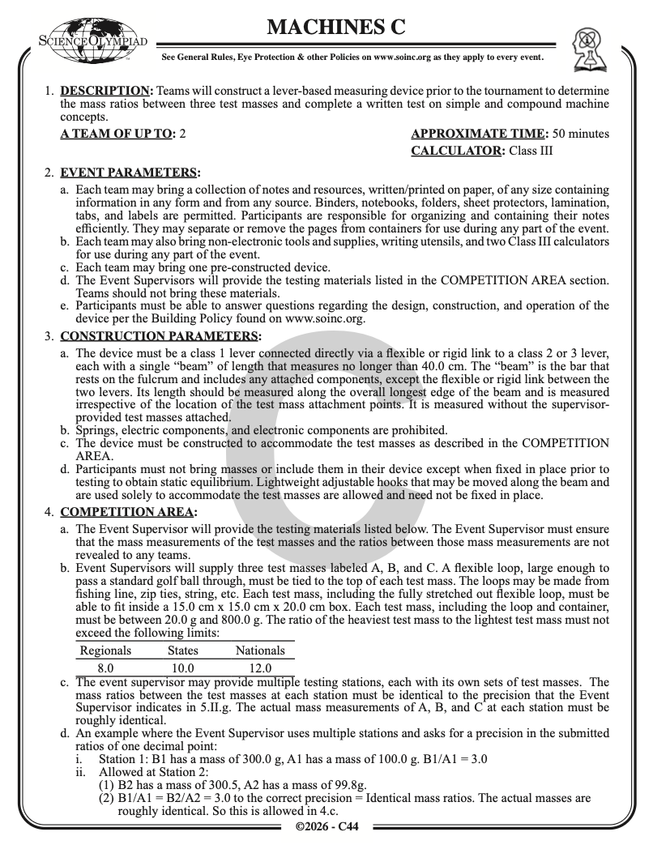
Event Overview
Hybrid (Test + Build Performance)
Exam mostly on Mechanics (Physics)
Build to find ratio of masses as fast as possible
Different by division
Div B:
Class 1 lever,
Max Mass Ratio: 8-12,
80cm Beam
Div C:
Compound machine,
Max mass ratio: 4-7
40cm Beam
Notes:
Highlight key points from the rules sheet: DESIGN LOGS that basically grant free points, most tested-on topics, point distribution so that competitors know what to prioritize, allowed notes and equipment, etc.
Talk about how not a pure build, based on performance use of it. Most tested topics will most likely be kinematics and mechanical advantage

Slide 4


BASIC MATH
Notes:
This section should focus on topics that are more math-based (harder to self-teach), concepts that come only usually up in college level courses, or concepts that you struggled with when you competed in this event

Slide 5
Basic Trig Crash Course
Picture a right triangle
Angles add up to 180 degrees, or pi radians
Let the angle x be the angle of interest
Sin(x) = Opposite⁄Hypotenuse
Cos(x) = Adjacent⁄Hypotenuse
Tan(x) = Opposite⁄Adjacent
And similarly, arcsin, arccos, and arctan are the inverses of these functions
arcsin(Opposite⁄Hypotenuse) = x
arccos(Adjacent⁄Hypotenuse) = x
arctan(Opposite⁄Adjacent) = x
The same can be done of the angle with the angle 90-x! Because the angle of interest changes, the adjacent and opposite sides flip and the same thing applies!
Adjacent
x
Opposite
Hypotenuse

Slide 6
Applying Trig to Vectors
A vector is a quantity with magnitude and direction
This vector is in 2-D plane
Can be represented in 2 ways:
Length and angle
x-component and y-component
We can switch between the two forms with trig!
sin(ፀ) = y⁄v => y = v*sin(ፀ)
cos(ፀ) = x⁄v => x = v*cos(ፀ)
tan(ፀ) = y⁄x => y = x*sin(ፀ)
And conversely…
V = sqrt(x^2 + y^2) (Pythagorean Theorem)
tan(ፀ) = y⁄x => ፀ = arctan(y⁄x) (Inverting the tan function)
Ta-dah!
V
y
ፀ
x

Slide 7
BASIC MECHANICS
Notes:
This section should focus on topics that are more math-based (harder to self-teach), concepts that come only usually up in college level courses, or concepts that you struggled with when you competed in this event

Slide 8




Kinematics!
x is position, measured in [m]
v is velocity(speed), the change in position [m/s]
a is acceleration, the change in velocity over time [m/s^2]
Naturally, we have that
What if velocity also changes? Then, we know that
Using (calculus), we can determine that
It can also be determined that
You can apply this to any object in a simple system, and approximate complicated systems really well!
→ these equations allow for solving of position, velocity, and acceleration for any moment in time during motion of an object.

Slide 9


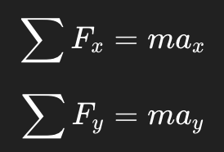

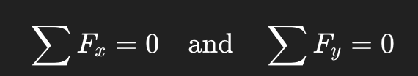
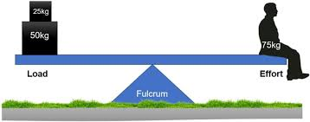

Forces & System Equilibrium
A force is something that changes the system
It is measured in Newtons, or [kg*m/s^2]
Changes the speed of something -> affects acceleration
Forces add up! Hence we can calculate a total force (and total acceleration
When the system does not move, this means that and so
(When adding forces(vectors), break them down into their xy components, add them in their respective dimensions, and transform back to overall vector form)
The inverse is true
Allows us to solve static systems
Prime example of a force:

Slide 10
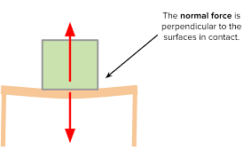
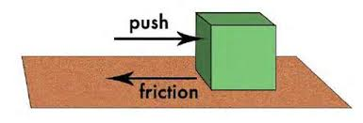


Friction
Normal force: an inherent “invisible” force which allows for the system to work out
In problems, usually comes from hardness of a material or gravity
Ex: pushing down on a table
Friction is a non-conservative force → loss of efficiency in the system
E.g. think of dragging a wooden box on a rough surface
Friction opposes the direction of motion → makes it harder to move!
Friction is a multiple of this “Normal Force”:
Can you figure out why?
For a simple object sitting on a surface, the normal force
Notes:
Feel free to add more topics and make sure that there are plenty of pictures/diagrams!

Slide 11
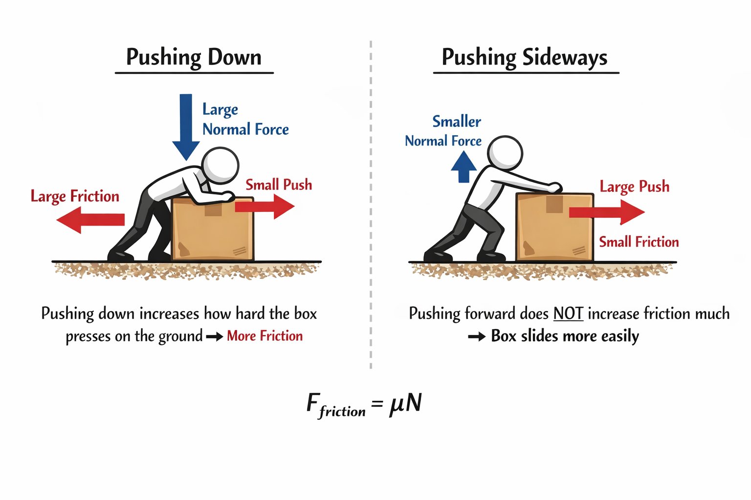
Friction
Notes:
Feel free to add more topics and make sure that there are plenty of pictures/diagrams!

Slide 12


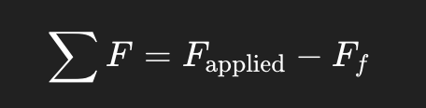
Static vs Kinetic
Static Friction is occurring when the object on which friction is being exerted is currently at rest
Kinetic Friction is occurring when the object on which friction is being exerted is currently moving
The coefficients of static friction and kinetic friction are different!
Harder when you start to move something than to keep moving it
Coeff. of static friction is always >= coeff of kinetic friction
Notes:
Feel free to add more topics and make sure that there are plenty of pictures/diagrams!

Slide 13
Recap of Kinematic Equations
Kinematics Forces & Eq. Friction

Slide 14


WORK AND ENERGY
Notes:
\

Slide 15


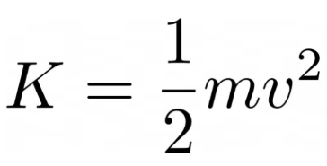



Work & Energy
Work is defined as the use of energy to apply a force over a distance
W = F*d, or, more formally, which often gives
Energy put into the system
Energy is defined as the ability to do work, two different kinds
Kinetic Energy (energy of movement);
Potential Energy (energy of position);
For gravity,
For springs,
For electric charges,
Notice how KE is the integral of momentum, while U is integral of Force!
Circular Definition!

Slide 16
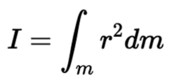

Rotational Energy
Same exact concepts for rotations!!
But what is “mass” in rotation?
Moment of inertia – How “hard” it is to rotate something —
Put a bunch of these in your binder!!! No need for calculus.
Redefining Forces and Energy in Rotational Kinematics,
A rotational force is called a Torque,
Rotational Kinetic energy is
Potential Energy is the same, there is no such thing as rotational potential
Relationship between linear and rotational lies in difference between speeds and accelerations
A ratio of the radius of rotation!
Switching between the two can help solving complex systems

Slide 17
Rotational mechanics
Translational | Rotational
F = ma | τ = Iα (= Fr)
v = v₀ + a t | ω = ω₀ + α t
Δx = ½ (v₀ + v) t | Δθ = ½ (ω₀ + ω)t
Δx = v₀t + ½ a t² | Δθ = ω₀ t + ½ α t²
v² = v₀² + 2 a Δx | ω² = ω₀² + 2 α Δx
Notes:
Feel free to add more topics and make sure that there are plenty of pictures/diagrams!

Slide 18


Conservation of Energy
Conservation of energy — for a closed system with only conservative forces, all of the energy is preserved at any moment in time no matter what happens in the system
Example: ball running down a hill, jumping, etc
Formally, and so
Conservative force: path-independent
Energy in system remains unchanged
Non-conservative force: path-dependent E.g. friction
For an open system with external and non-conservative forces
So what is a system?
Anything which is relevant in the given scenario or which contributes to a change in energy of any component, including itself. E.g. a group of objects
Notes:
Feel free to add more topics and make sure that there are plenty of pictures/diagrams!

Slide 19
SIMPLE MACHINES
Notes:
\

Slide 20
Simple machines
Simple machines can…
Change direction of force
Reduce the force needed to do the same amount of work
Reduce the distance needed to do the same amount of work
Recall Work = Force * distance
Idea: amount of work done remains the same
Notes:
Feel free to add more topics and make sure that there are plenty of pictures/diagrams!

Slide 21
Simple machines overview
Relevant machines
First, second, and third class levers
Inclined planes
Wedges
Wheel and axle (and gears)
Pulleys
Screws
Calculations
Solving for mechanical advantage
Solving for efficiency
Solving for work done
TL;DR – Using basic mechanics, solve for different parts of the equations.

Slide 22
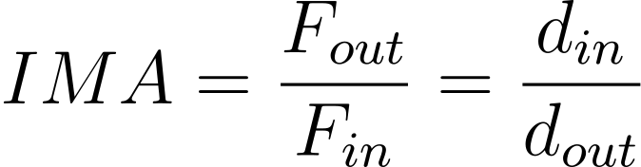
Why care?
Simple machines can…
Change direction of force
Reduce the force needed to do the same amount of work
Reduce the distance needed to do the same amount of work
Recall Work = Force * distance
Ideal mechanical advantage
Idea: amount of work done remains the same
Notes:
Feel free to add more topics and make sure that there are plenty of pictures/diagrams!

Slide 23
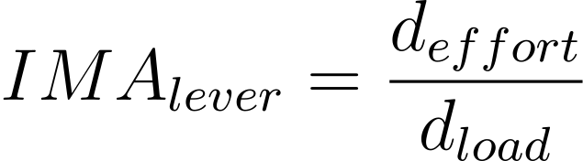
Levers
Class 1 Lever
Effort
Load
Fulcrum

Slide 24
Levers
Class 1 Lever
Effort
Load
Fulcrum

Slide 25
Levers
Class 1 Lever
Effort
Load
Fulcrum

Slide 26
Levers
Effort
Load
Class 1 Lever
Effort
Load
Class 2 Lever
Load
Effort
Class 3 Lever

Slide 27
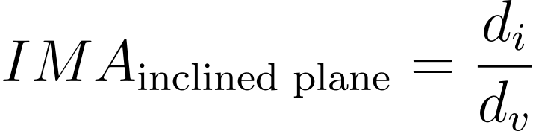

Inclined Planes
load
θ
Notes:
Feel free to add more topics and make sure that there are plenty of pictures/diagrams!

Slide 28



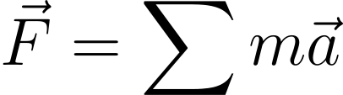

Setting up forces on inclined planes
Direction of movement
Problem setup:
Notes:
Feel free to add more topics and make sure that there are plenty of pictures/diagrams!

Slide 29
Setting up forces on inclined planes
Direction of movement
|F_friction| > 0 → Less than ideal mechanical advantage (we’ll come back to this later)
Notes:
Feel free to add more topics and make sure that there are plenty of pictures/diagrams!

Slide 30
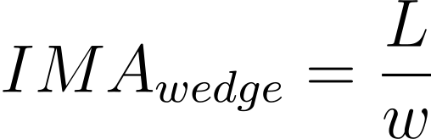
Wedges
Examples: axe head, knives, doorstops, zippers
Notes:
Feel free to add more topics and make sure that there are plenty of pictures/diagrams!

Slide 31
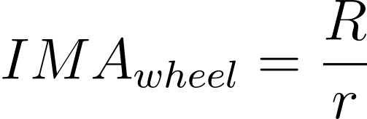
Wheels and Axles
For a simple wheel and axle
Note the load and effort can be reversed (invert given IMA equation)
Problem set-up: using ratios
load
Notes:
Feel free to add more topics and make sure that there are plenty of pictures/diagrams!

Slide 32
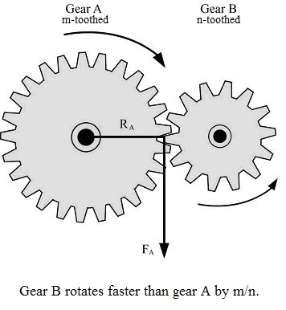
Gears
Type of compound machine
Gear systems
Transmission of torque
Problem set-up:
Use gear tear count to define ratios
Use ratios to solve input/output force or distance problems
Intuition
↑gear A teeth ⇒ ↑ number of rotations
Image from the Scioly Wiki.
Notes:
Feel free to add more topics and make sure that there are plenty of pictures/diagrams!

Slide 33
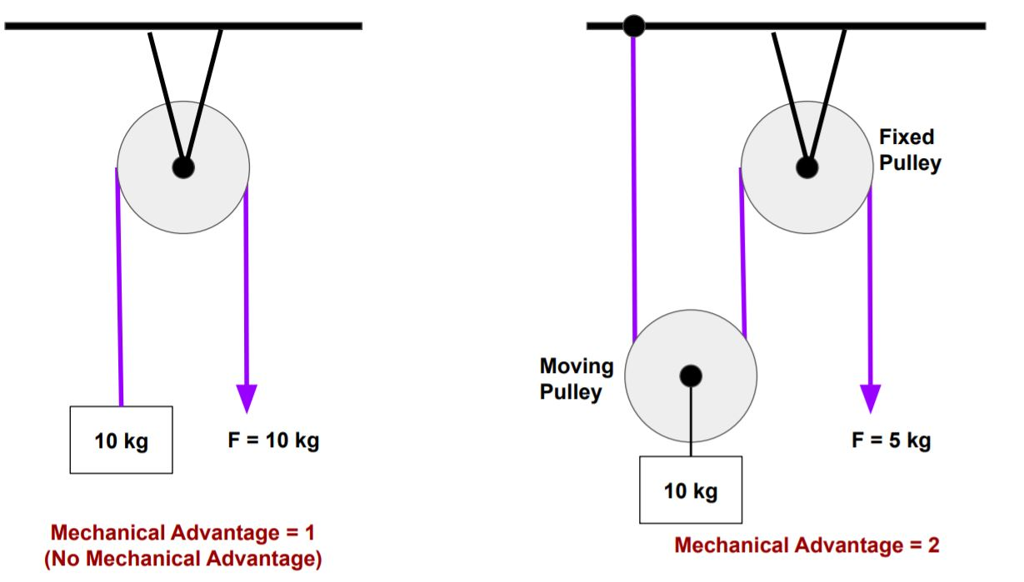
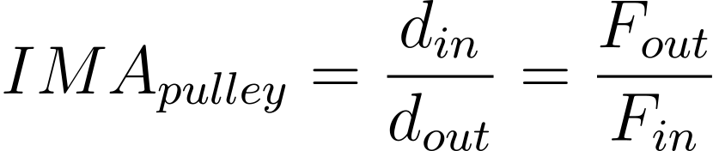
Pulleys
Single pulley: class 1 lever
More useful with multiple pulleys
Heuristic: IMA = count the number of supporting lines lifting the load
Image source
Notes:
Feel free to add more topics and make sure that there are plenty of pictures/diagrams!

Slide 34
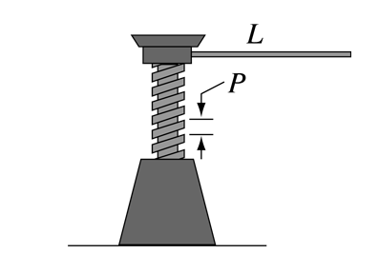
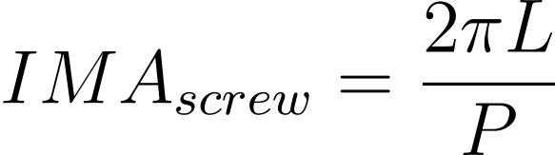
Screws
Inclined plane wrapped around a cylinder
P := pitch (distance between threads)
L := “radius” of the turn of the screw
Recall: circumference of circle is 2𝝿r
Image from Hyperphysics.
Notes:
Feel free to add more topics and make sure that there are plenty of pictures/diagrams!

Slide 35
Example Generic Problem Types
Calculate mechanical advantage
Comparing ideal MA to actual MA (with friction)
Calculate net force
Calculate acceleration
Q: How does acceleration work with spinning objects?
Notes:
Feel free to add more topics and make sure that there are plenty of pictures/diagrams!

Slide 36
Rotational Mechanics
Question: How do kinematics relate to simple machines?
Special case for rotational kinematics
Describes spinning motion, not straight line movement
Motion
Angle: θ
Angular velocity: ω
Angular acceleration: α
Forces
Torque: τ
Relationship to translational kinematics:
v = rω Δs = r Δθ a = rɑ
Notes:
Feel free to add more topics and make sure that there are plenty of pictures/diagrams!

Slide 37
Rotational mechanics
Translational | Rotational
F = ma | τ = Iα (= Fr)
v = v₀ + a t | ω = ω₀ + α t
Δx = ½ (v₀ + v) t | Δθ = ½ (ω₀ + ω)t
Δx = v₀t + ½ a t² | Δθ = ω₀ t + ½ α t²
v² = v₀² + 2 a Δx | ω² = ω₀² + 2 α Δx
Notes:
Feel free to add more topics and make sure that there are plenty of pictures/diagrams!

Slide 38
What is I?
I := moment of Inertia
“Mass” analogue in rotational kinematics
Relevant formulas:
Cylinder or disk, symmetry axis Pulleys Wheel and axle | I = ½ MR², R := radius
Rod around non-center Lever | I = ⅓ ML², L := length
Point mass | I = Mr², r := distance from axis of rotation
Notes:
Feel free to add more topics and make sure that there are plenty of pictures/diagrams!

Slide 39
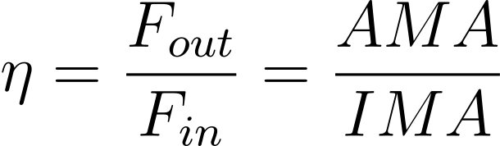
Ideal versus actual MA
Recall: friction acts against direction of motion – loss of energy
AMA := actual mechanical advantage
IMA := ideal mechanical advantage
Example problem types:
Given the efficiency, calculate the actual force needed to do X amount of work
Given the output force and some input force, calculate the efficiency
Given the coefficient of friction, calculate the efficiency of the system
Notes:
Feel free to add more topics and make sure that there are plenty of pictures/diagrams!

Slide 40





Additional Resources
Rules Manuals
Machines Wiki
Division B
Division C
Science Olympiad Test Archive
Kinematics Examples and Math
SUBWAY STATIONS
Yes, Saturn is the ringed one. This planet is a gas giant, and it’s composed mostly of hydrogen and helium
Notes:
Here, you can link or mention any online or book resources that helped you in this event when you were a competitor. Try to avoid general resources like scioly wiki, because they probably already are familiar with it.

Slide 41
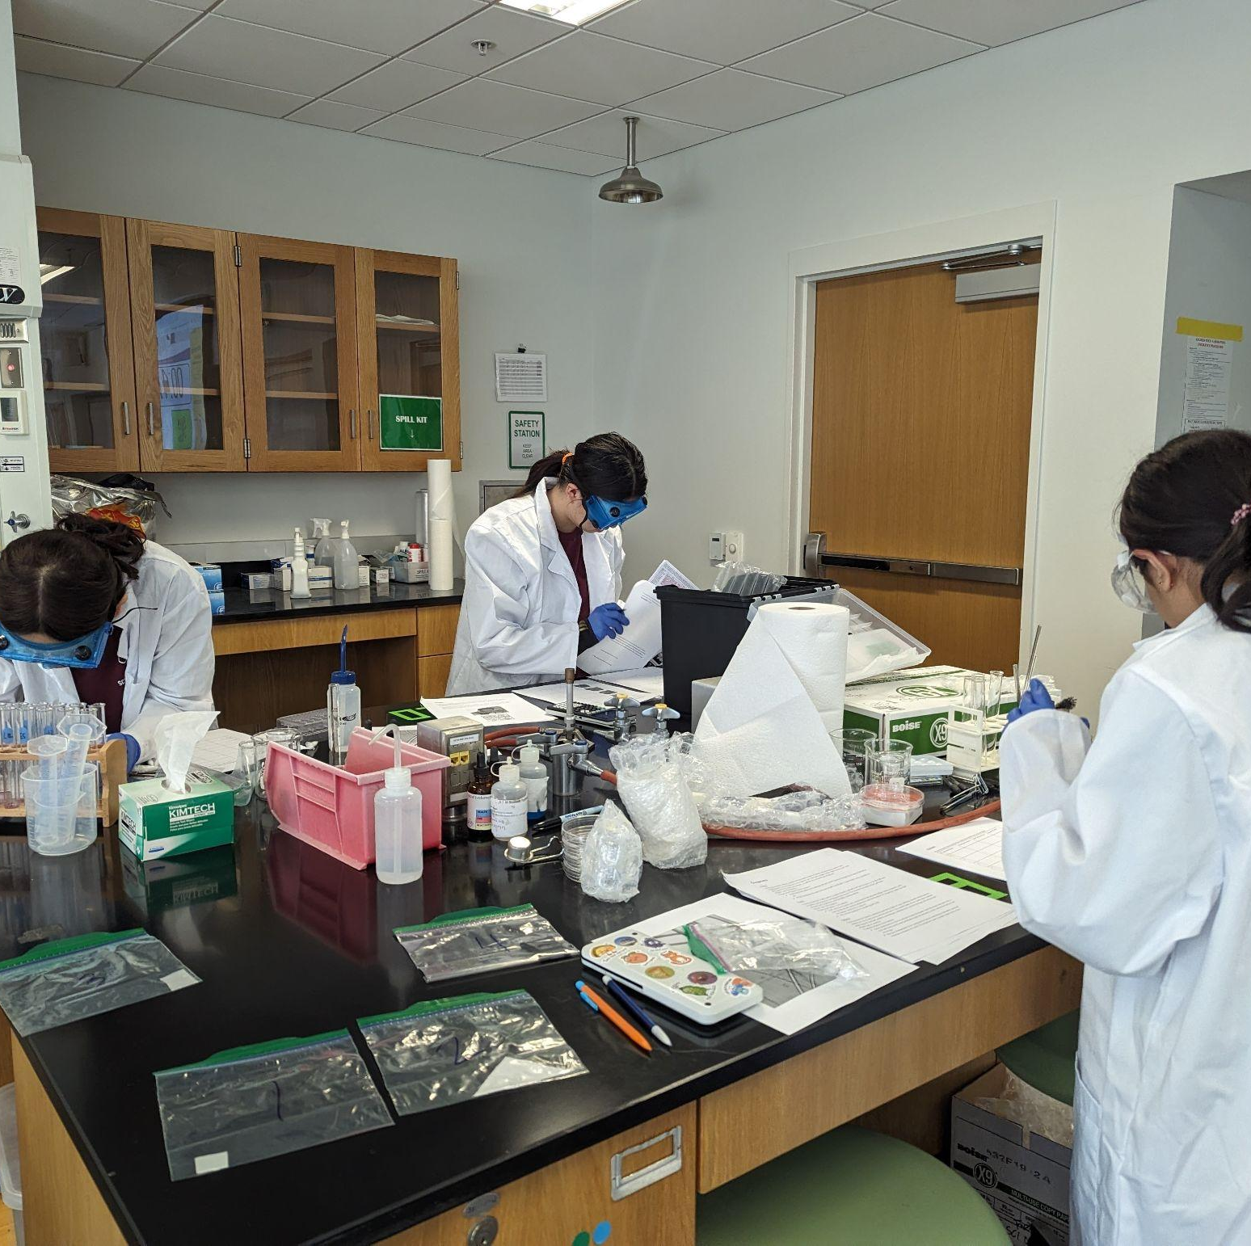
THANKS!
Notes:
(replace picture with a picture from one of our tournaments)

